Slide 1
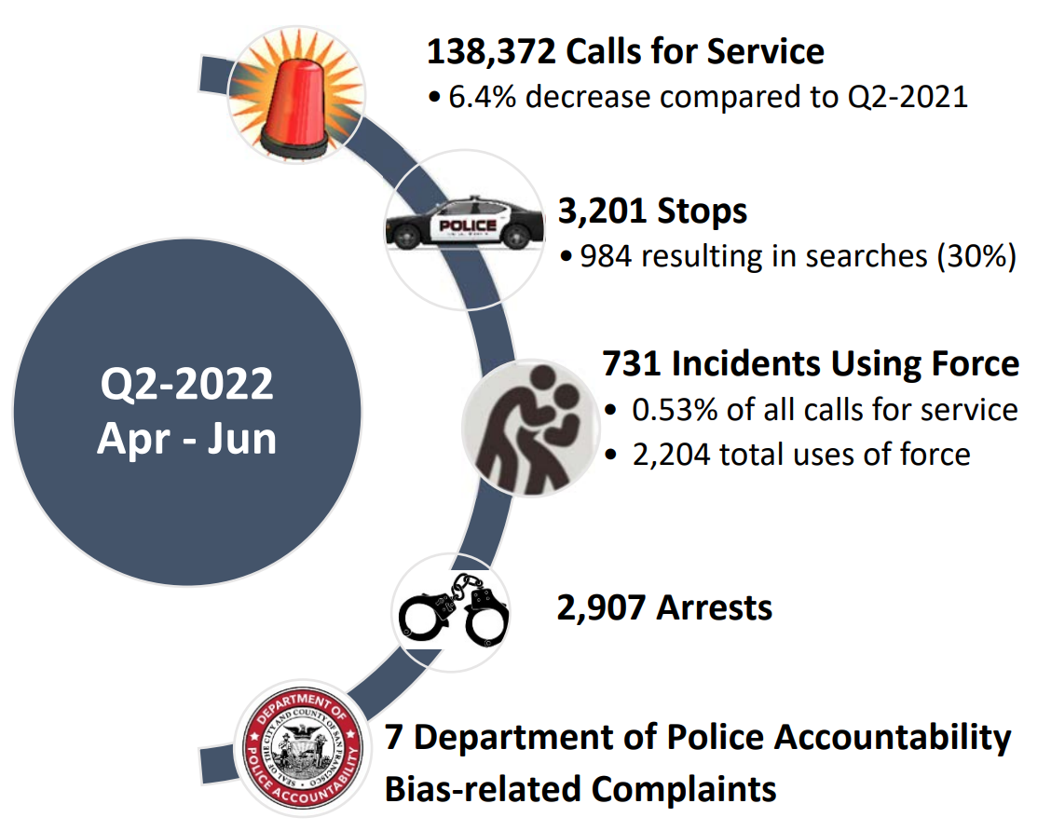
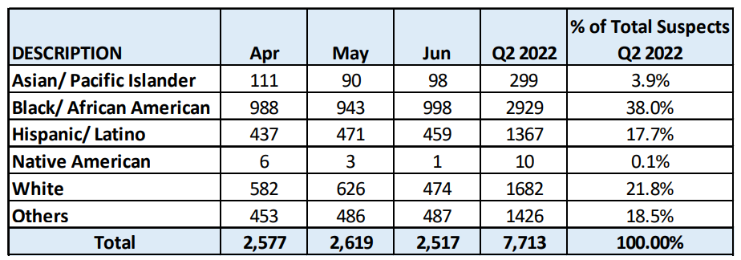
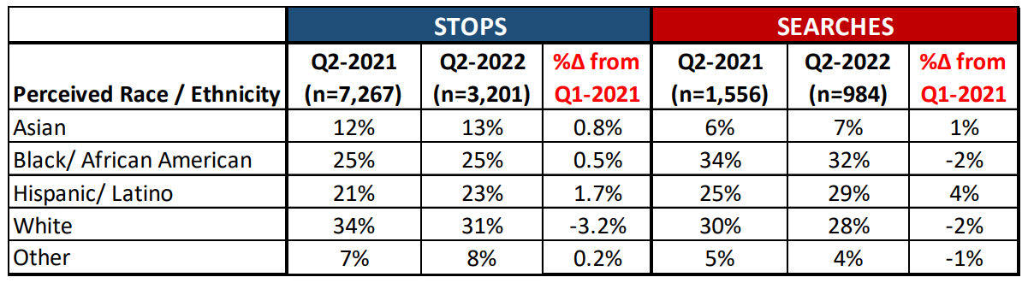
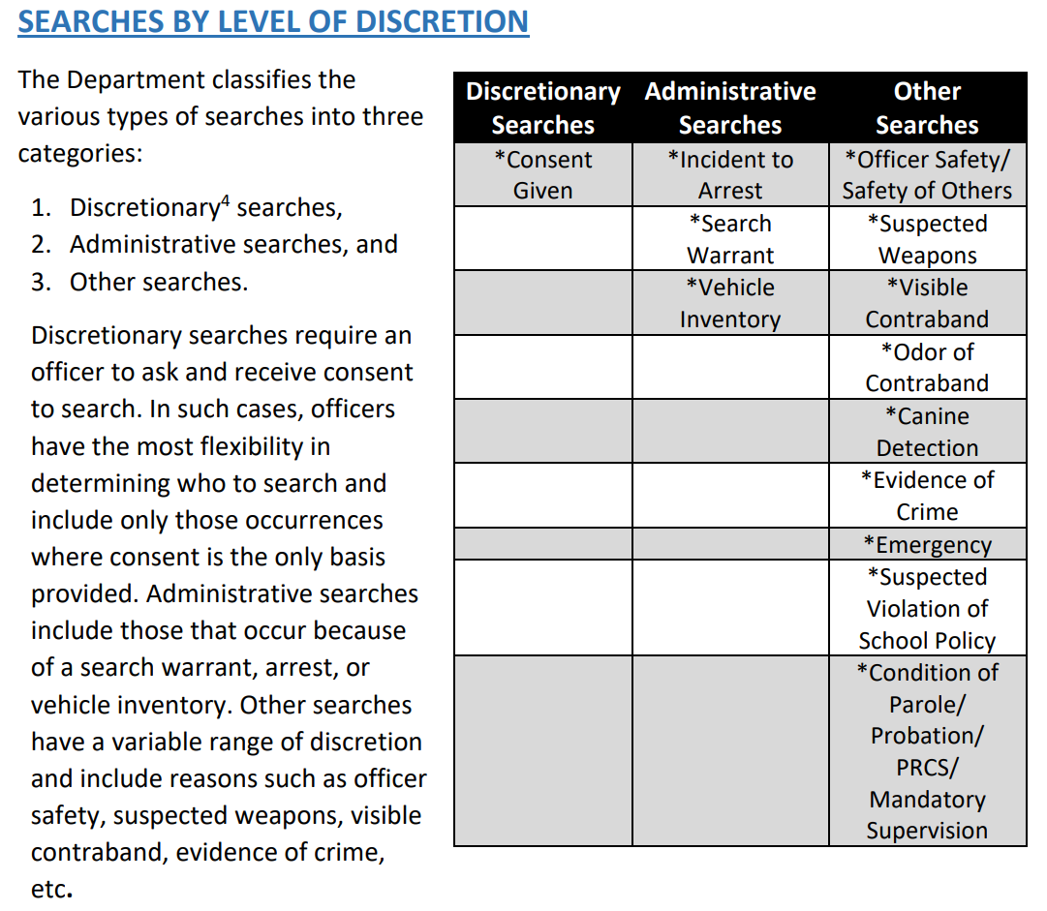
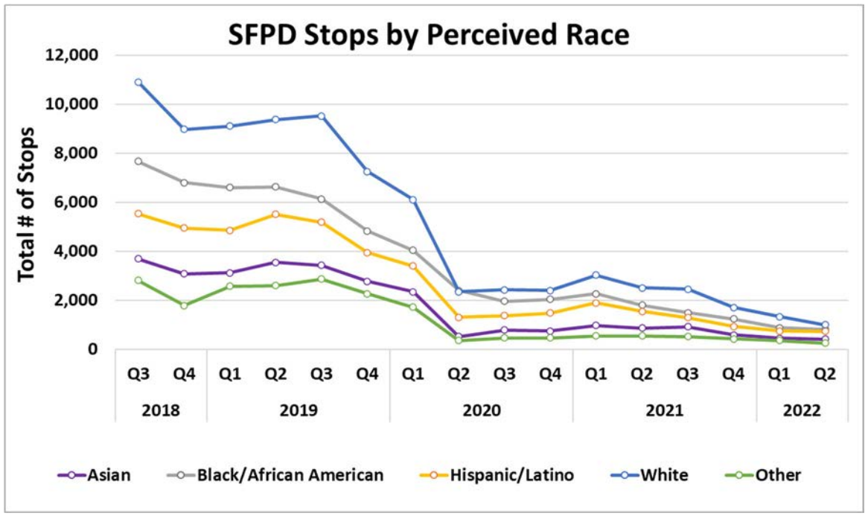
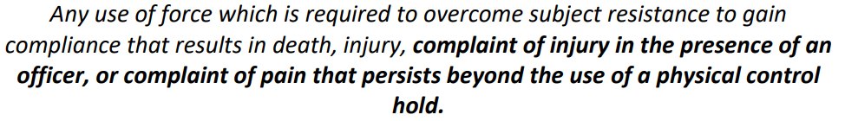
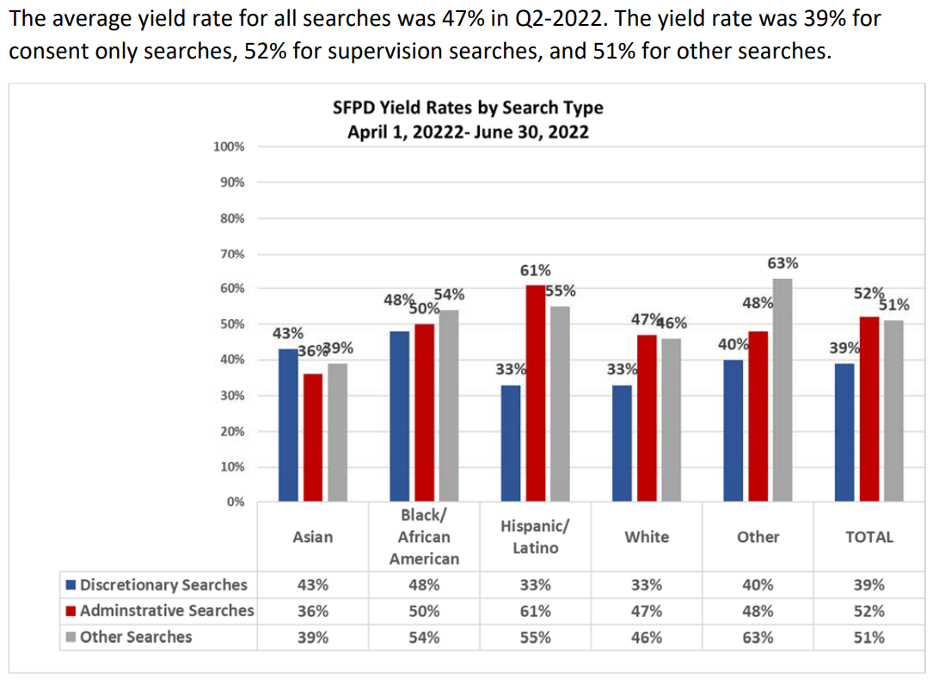
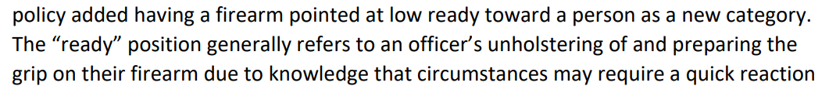
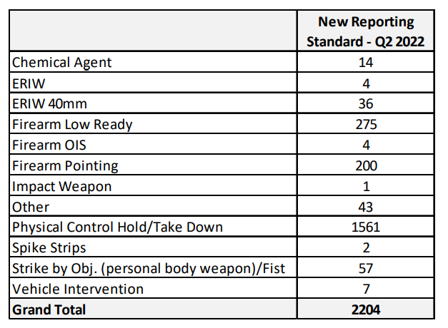
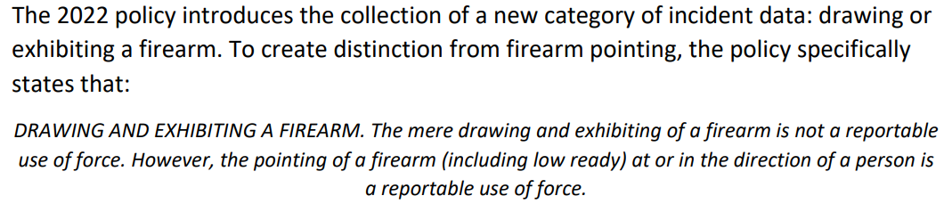
number of calls for service
number of calls for service per capita population 1000 individuals
number of stops
number of searches
number of incidents using force
number of arrests
number of arrests by district
number of suspects and observed and reported by genre
type of used force
number of incidents where used force and result in death
Physical Control Threshold
Firearm Pointing
Drawing and Exhibiting a Firearm

Slide 2
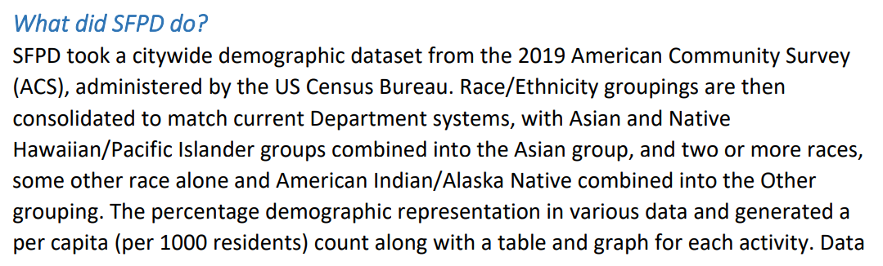
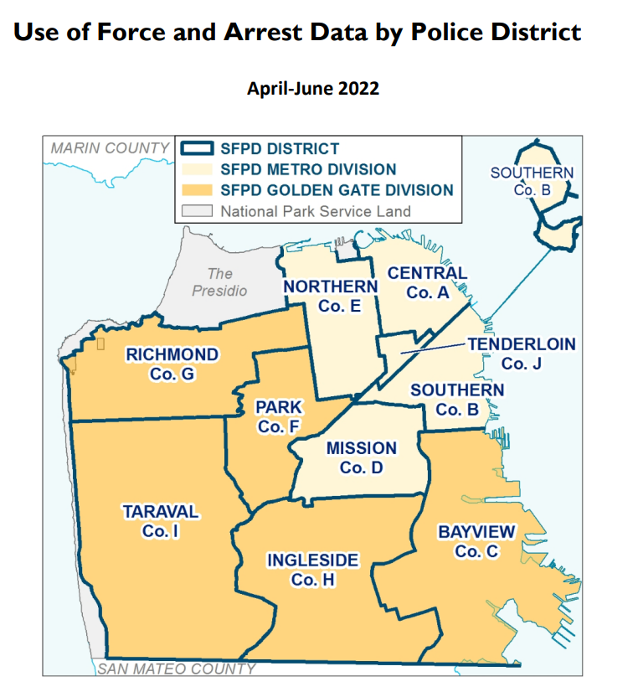
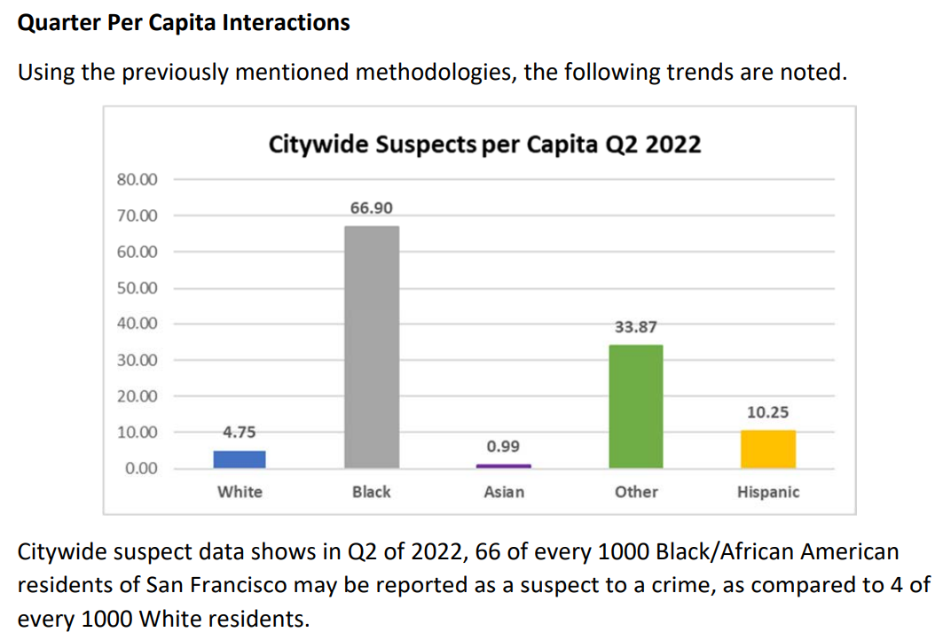
Population Benchmark Analysis, Per Capita Race/Ethnicity
number of domestic violence calls for service and investigations
confiscation of weapons
presence of childrens
citywide searches per capita
citywide use of force per capita
citywide arrests per capita
per capita interactions by race
stops per capita

Slide 3
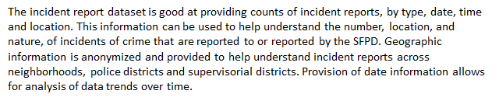
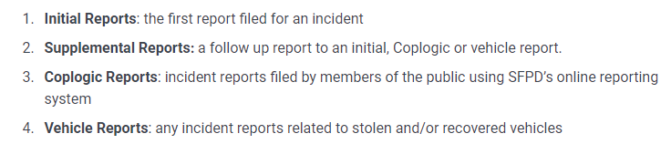
If changes or additional information is required or discovered during an investigation, a supplemental report may be generated to capture updates.
Incident reports can have one or more associated Incident Codes.
The Incident ID, Incident Number and CAD Numbers remain the same and the Row ID field can be used as a unique identifier for each row of data.
All incident locations are shown at the intersection level only.
Coordinates associated with incident locations provided within the dataset are anonymized and reflect the nearest intersection of each occurrence.

